Slide 1

UNIVERSITY OF IBADAN
PRESENTATION
ON
STUDENT INDUSTRIAL WORK EXPERIENCE SCHEME
(SIWES)
AT
MINISTRY OF ECONOMIC PLANNING AND BUDGET, SECRETARIAT, IKEJA, LAGOS
BY
OLANREWAJU DANIEL AYOMINDE
205571
MAT 399
DEPARTMENT OF MATHEMATICS
FACULTY OF SCIENCE
UNIVERSITY OF IBADAN

Slide 2
TITLE COMPUTATIONAL MATHEMATICS AND DEEP LEARNING

Slide 3
CONTENT
Introduction
Experience gained
a) Project overview
b) The MNIST dataset
Steps in building a deep learning project
Recommendation.
Conclusion.

Slide 4
INTRODUCTION
At the dawn of the 21st century, computation and algorithm translated into a more sophisticated tool for making work easier, lives better, and education an endless adventure. Mathematics as a base and foundation for cryptography and enigmas as in Algebra, has given the world an opportunity to see into the adventure and take advantage of opportunities embedded in the subject matter.
Deep learning, Machine leaning, Natural language processing, robotics and predictive analysis are the subdivisions of AI that are transforming industries in all fields.
Since my industrial training was supported by the Lagos Bureau of Statistics, data science and deep learning was inevitable for me. They also gave access to data scientists network lab in the ministry building, showing Lagos state government’s commitment to AI innovation.
Deep learning in modern governmental establishments is a vital prognostication tool for effective administration, response, and service delivery among others. Deep learning enhances security, produces greater scalability, improve usability, enhances better decision making among others.
In this report, I considered various application of statistics, and these areas can also be transformed through the use of deep learning and computational mathematics.

Slide 5
EXPERIENCE GAINED
I built a machine learning model using the MNIST dataset.
MNIST dataset is a classic in the machine-learning community, which has been around almost as long as the field itself and has been intensively studied.
It’s a set of 60,000 training images, plus 10,000 test images, assembled by the National Institute of Standards and Technology (the NIST in MNIST) in the 1980s.
You can think of “solving” MNIST as the “Hello World” of deep learning—it’s what you do to verify that your algorithms are working as expected. For anyone that will do machine-learning as a profession, you’ll see MNIST come up over and over again, in scientific papers, blog posts, and so on.

Slide 6
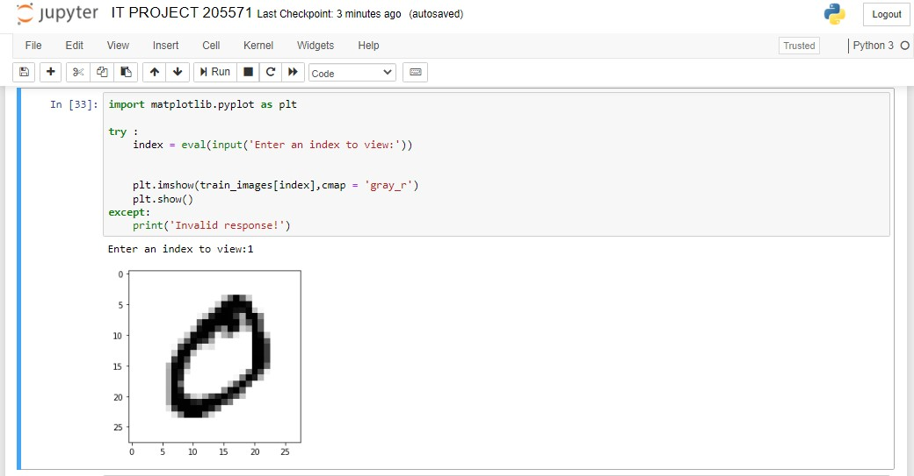
STEPS IN BUILDING A DEEP LEARNING PROJECT
STEP 1
DATA COLLECTION AND DATA IMPORTATION
For this project, there was no data collection. The MNIST dataset was used .
train_images and train_labels form the training set, the data that the model will learn from. The model will then be tested on the test set, test_images and test_labels. The images are encoded as NumPy arrays, and the labels are an array of digits, ranging from 0 to 9. The images and labels have a one-to-one correspondence.
from keras.datasets import mnist (train_images, train_labels), (test_images, test_labels) = mnist.load_data()
An image from the dataset

Slide 7
STEPS IN BUILDING A DEEP LEARNING PROJECT
STEP 2
RESHAPING THE IMAGES AND CONVERTION TO CATEGORICAL
Before training, we’ll preprocess the data by reshaping it into the shape the network expects and scaling it so that all values are in the [0, 1] interval. Previously, our training images, for instance, were stored in an array of shape (60000, 28, 28) of type uint8 with values in the [0, 255] interval. We transform it into a float32 array of shape (60000, 28 * 28) with values between 0 and 1.
Also, we categorically encode the labels.
train_images = train_images.reshape((60000, 28 * 28))
train_images = train_images.astype('float32') / 255
test_images = test_images.reshape((10000, 28 * 28))
test_images = test_images.astype('float32') / 255
from keras.utils import to_categorical
train_labels = to_categorical(train_labels)
test_labels = to_categorical(test_labels)
val_data = train_images[:10000]
val_label = train_labels[:10000]

Slide 8
STEPS IN BUILDING A DEEP LEARNING PROJECT
STEP 3
CREATING A VALIDATION SET AND BUILDING THE DEEP LEARNING MODEL
In order to monitor the accuracy of the model on data it has never seen before, I created a validation set by setting apart 10,000 samples from the original training data.
from keras import optimizers
from keras import models
from keras import layers, regularizers
network = models.Sequential()
network.add(layers.Dense(450,activation='relu', input_shape=(28 * 28,)))
network.add(layers.Dropout(0.5))
network.add(layers.Dense(450, activation='relu'))
network.add(layers.Dropout(0.5))
network.add(layers.Dense(10, activation='softmax'))

Slide 9
STEPS IN BUILDING A DEEP LEARNING PROJECT
STEP 4
BUILDING A CLASS FOR CALLBACKS
Every deep learning model may not be will not always have a 100% accuracy rate, but, an 80% accuracy rate and above is acceptable. For my project, I set the maximum at 99% and minimum at industry’s standard of 80%.
I defined a class StopCallback to stop the epochs from continuing when a 99% accuracy is achieved.
import keras
class StopCallback(keras.callbacks.Callback):
def on_epoch_end(self, epoch, logs={}):
if(logs.get('accuracy')>0.999):
print("\nReached 99% accuracy so cancelling training!")
self.model.stop_training = True
callbacks = StopCallback()

Slide 10
STEPS IN BUILDING A DEEP LEARNING PROJECT
STEP 5
MODEL COMPILATION
Every deep learning model may not be will not always have a 100% accuracy rate, but, an 80% accuracy rate and above is acceptable. For my project, I set the maximum at 99% and minimum at industry’s standard of 80%.
I defined a class StopCallback to stop the epochs from continuing when a 99% accuracy is achieved.
import keras
class StopCallback(keras.callbacks.Callback):
def on_epoch_end(self, epoch, logs={}):
if(logs.get('accuracy')>0.999):
print("\nReached 99% accuracy so cancelling training!")
self.model.stop_training = True
callbacks = StopCallback()

Slide 11
STEPS IN BUILDING A DEEP LEARNING PROJECT
STEP 6
MODEL COMPILATION
To make the network ready for training, we need to pick three more things, as part of the compilation step: A loss function, Metrics to monitor during training and testing, An optimizer.
To avoid overfitting, 5 Epochs was performed on the training set
network.compile(optimizer= 'Adam',
loss='categorical_crossentropy',
metrics=['accuracy'])
history = network.fit(train_images, train_labels, epochs=5, batch_size=200, validation_data = [val_data,val_label])

Slide 12
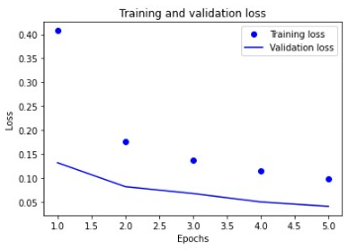
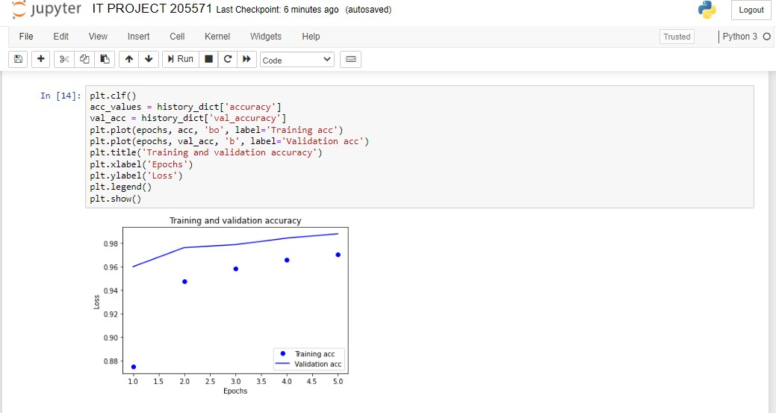
STEPS IN BUILDING A DEEP LEARNING PROJECT
STEP 7
VISUALIZING THE MODEL ACCURACY USING MATPLOTLIB
After training, the training loss decreases with every epoch, and the training accuracy increases with every epoch. That’s what you would expect when running gradient-descent optimization—the quantity you’re trying to minimize should be less with every iteration.
On the right hand side, we have the plot of the training and the validation set performance.

Slide 13
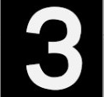
STEPS IN BUILDING A DEEP LEARNING PROJECT
STEP 8
TESTING THE RELIABILITY OF MY MODEL
Finally, I tested the reliability of my model by testing a random picture named ‘test.jpg’ shown below for prediction.
import cv2 as cv
image = cv.imread('test.jpg')
cv.imshow('test.jpg', image)
cv.waitKey(0)
image=cv.imread('test.jpg',cv.IMREAD_GRAYSCALE)
# image = test_images[1]
image = cv.resize(image, (28,28))
plt.imshow(image, cmap = 'Greys')
plt.show()
image= image.reshape(1,28*28)
image = image.astype('float32')/255
# image = 255-image
pred = network.predict(image)
print('The writing is',pred.argmax())

Slide 14
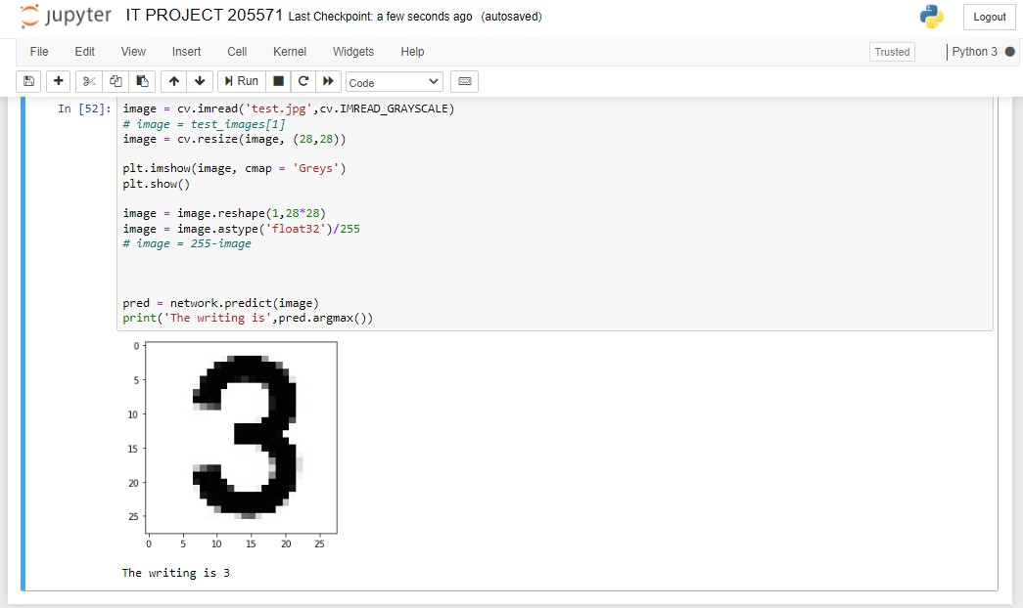

Slide 15
RECOMENDATION
I recommend that
The mathematics topics in Machine learning and deep learning be made into a course in mathematics department. As there was a barrier of filtering out topics that are related to big data models as the relationship between mathematics and statistics.
Knowledge of Microsoft Excel or Microsoft Power BI be made a requirement to get a job as a civil servant .
Also computer literacy should be made compulsory for all civil servant.
Reasonable grants be given to students on 3 months industrial training.
Regular visitation of IT supervisors.

Slide 16
THANK YOU FOR LISTENING

